Slide 1
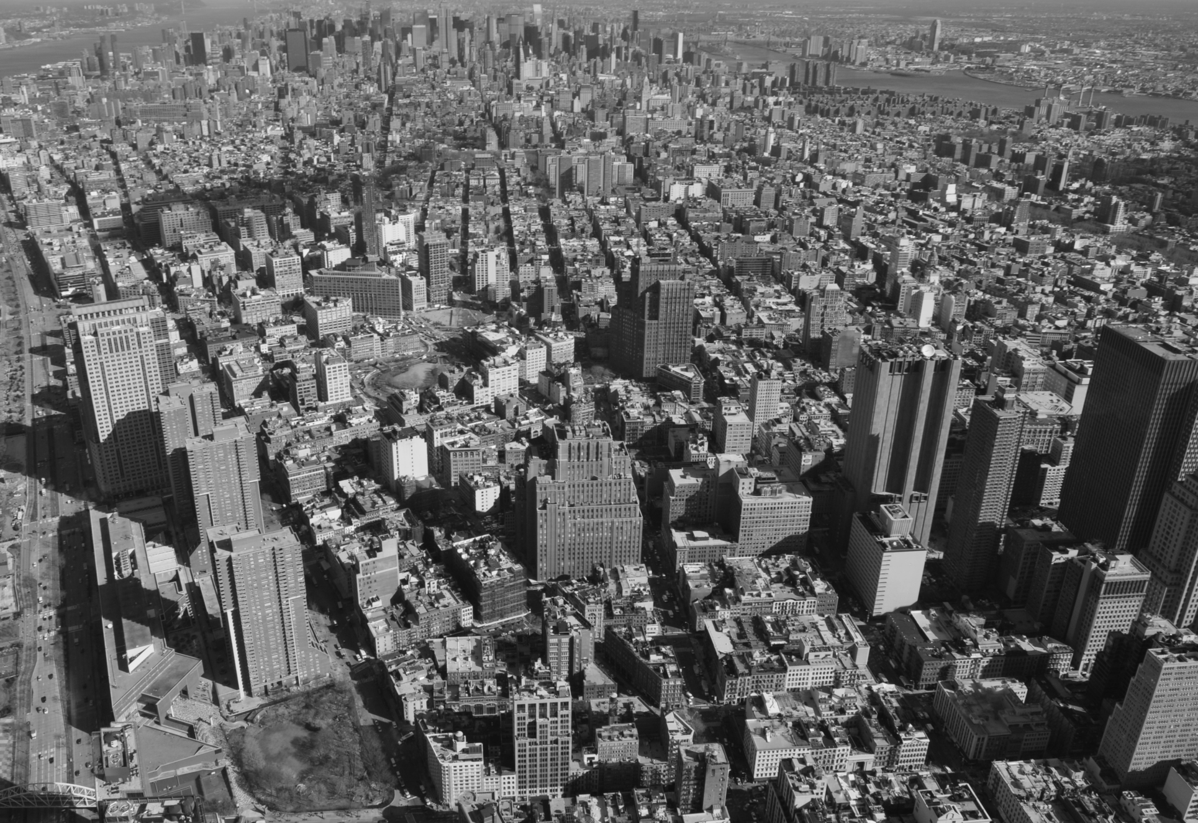
LOCAL LAW 116 OF 2017 ANNUAL REPORT
December 2021
build safe|live safe

Slide 2
background
This annual report has been prepared pursuant to Local Law 116 of 2017, which was enacted on July 22, 2017.

Slide 3
LOCAL LAW 116 OF 2017
Privately Owned Public Space (“POPS”) complaints received and enforcement actions taken by the Department of Buildings (“the Department”) in 2021.
In 2021, the Department received 80 complaints. Upon inspection, the Department determined that no enforcement action was necessary with respect to 56 complaints. The Department issued 24 violations where it determined that an enforcement action was necessary.
Whether the Department authorized closure of a POPS in 2021, and, if so, the duration of and reason for each such closure.
In 2021, 14 POPS were closed, 11 of which were full closures and 3 which were partial closures. 6 closures were authorized. The Department issued violations in 8 closures that were unauthorized.

Slide 4
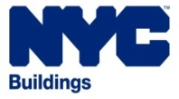
build safe|live safe

