Slide 1
OFFICE OF THE TENANT ADVOCATE QUARTERLY REPORT
Third Quarter of 2024
build safe|live safe

Slide 2
OFFICE OF THE TENANT ADVOCATE
BACKGROUND
This quarterly report for the Office of the Tenant Advocate (OTA) has been prepared pursuant to Local Law 161 of 2017 and covers the third quarter of 2024.

Slide 3
Ota: inquiries & complaints
INQUIRIES
Following are inquiries received by OTA :
Work Without a Permit complaints
Failure to comply with Tenant Protection Plan (TPP) or unsafe construction complaints
Failure to post a TPP Notice or Safe Construction Bill of Rights complaints
Inquiries pertaining to Department processes (i.e., How to Post or Deliver TPPs)
Insufficient TPPs
Questions about the TPP Special Inspection requirement

Slide 4
Ota: inquiries & complaints
COMPLAINTS
Following is the number of complaints received by OTA with a description of each complaint:
This quarter OTA received 464 inquiries. Those complaints resulted in 214 inspections by DOB’s Multiple Dwelling Inspections (MDI) Unit and/or other DOB enforcement units and 187 referrals to other City and State agencies.
Where a tenant harassment inquiry requires an inspection, the MDI Unit is currently performing such inspection within .757 days of the date of referral.
Additionally, OTA conducted proactive portfolio research in 189 buildings identified as at risk and referred 9 Tenant Protection Plans for audit.

Slide 5
Ota: TENANT communication
OTA interacts with tenants on a regular basis and serves as a resource to community-based organizations, City/State/Federal elected officials, and government agencies.
The following describes OTA’s communication efforts to Tenants:
OTA participates in the bi-monthly meetings of the North Brooklyn Housing Task Force with local community groups, elected officials, and City/State agencies.
In August 2024, OTA participated at Pa’lante Demystifying Housing Conference to present a seminar on Tenant Protection Plans, followed by a round table panel discussion on Tenant Harassment.
Listed on DOB’s website, OTA can be reached by phone at (212) 393-2550 or email at tenantadvocate@buildings.nyc.gov.
NEW fillable complaint form Tenants can complete and email to OTA.

Slide 6
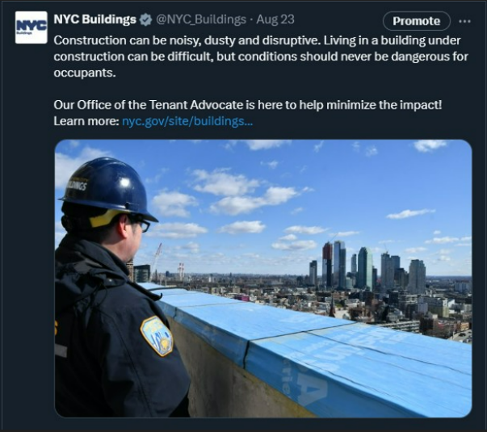
Ota: communication efforts

Slide 7
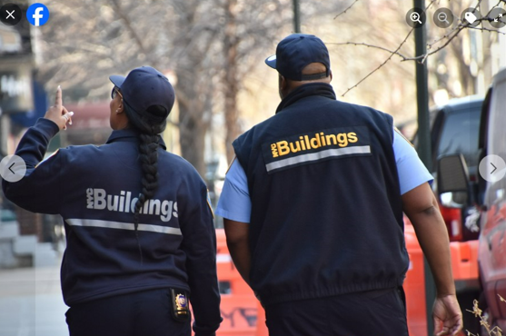
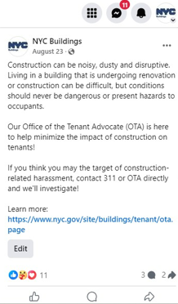
Ota: communication efforts

Slide 8
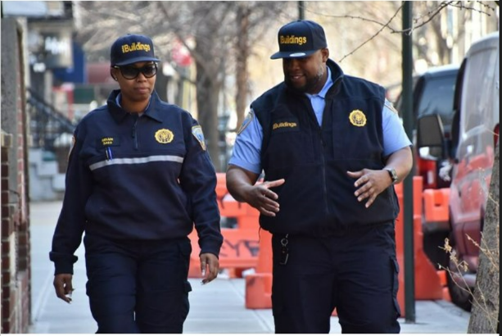
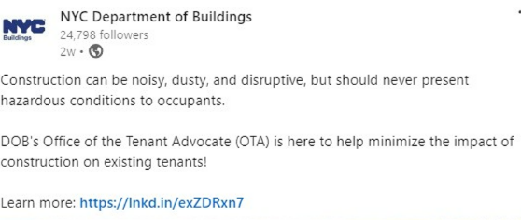
Ota: communication efforts

Slide 9
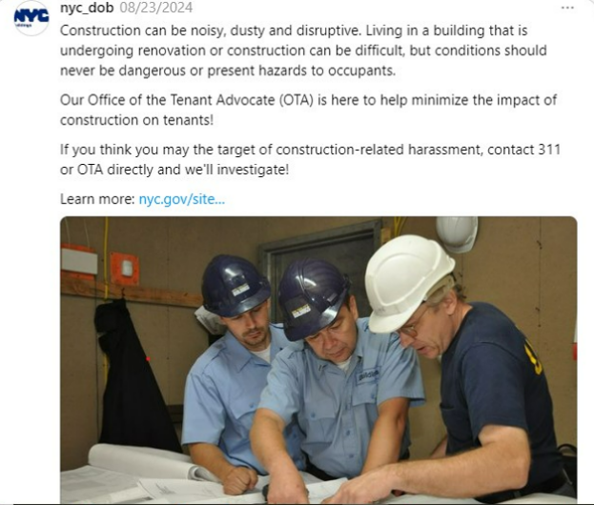
Ota: communication efforts

Slide 10
Ota: communication efforts

Slide 11
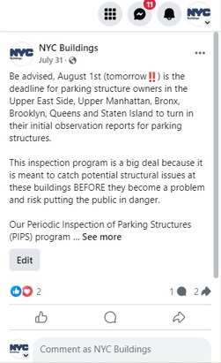
Ota: communication efforts

Slide 12
Ota: TENANT safety inspections
The number of inspections conducted by the MDI Unit related to tenant harassment and TPP compliance are as follows:
This quarter, MDI conducted 301 inspections stemming from tenant harassment complaints, resulting in 211 violations and 41 Stop Work Orders (SWOs).
Additionally, 289 proactive MDI TPP compliance inspections resulted in 36 violations for unsafe conditions and 28 Stop Work Orders (SWOs).
242 six-month re-inspections for TPP compliance resulted in 17 violations and 9 SWOs.
Finally, as a result of 262 proactive inspections, 30 violations, and 10 SWOs were issued to contractors who are listed on the Department of Buildings’ published watch list for contractors found to have performed work without a required permit in the preceding 2 years
*includes OTA referrals

